Slide 1
Lesson 2
Imran spent 50p on a drink. He used a £1 coin. How much change did he get?
With his change he gave his brother 15p. How much is left?...
How much more does he need to buy sweets costing 40p?

Slide 2


Concept: Fractions
Small Step: Unit and Non
Unit Fractions
© Classroom Secrets Limited 2019

Slide 3
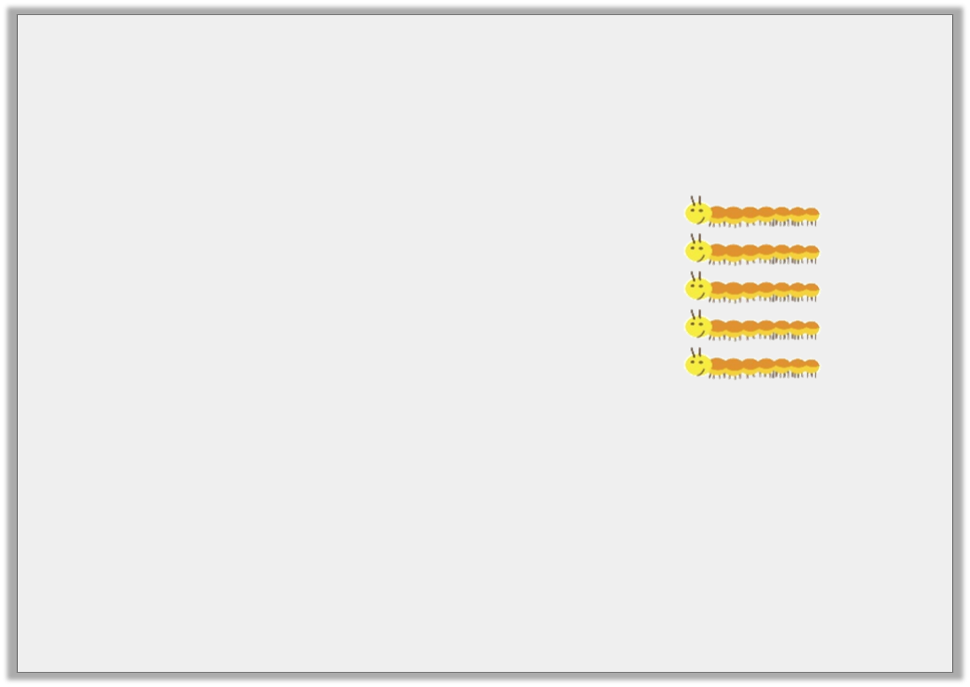
Problem Solving 1
Match the fractions shown by the shaded or circled sections and find the odd one out. Circle the unit fractions.
Three out of seven
2
5
1
11
1
9
Y3
© Classroom Secrets Limited 2019

Slide 4
Problem Solving 1
Match the fractions shown by the shaded or circled sections and find the odd one out. Circle the unit fractions.
is the odd one out. and are unit fractions.
Three out of seven
2
5
1
11
1
9
1
11
1
11
1
9
Y3
© Classroom Secrets Limited 2019

Slide 5
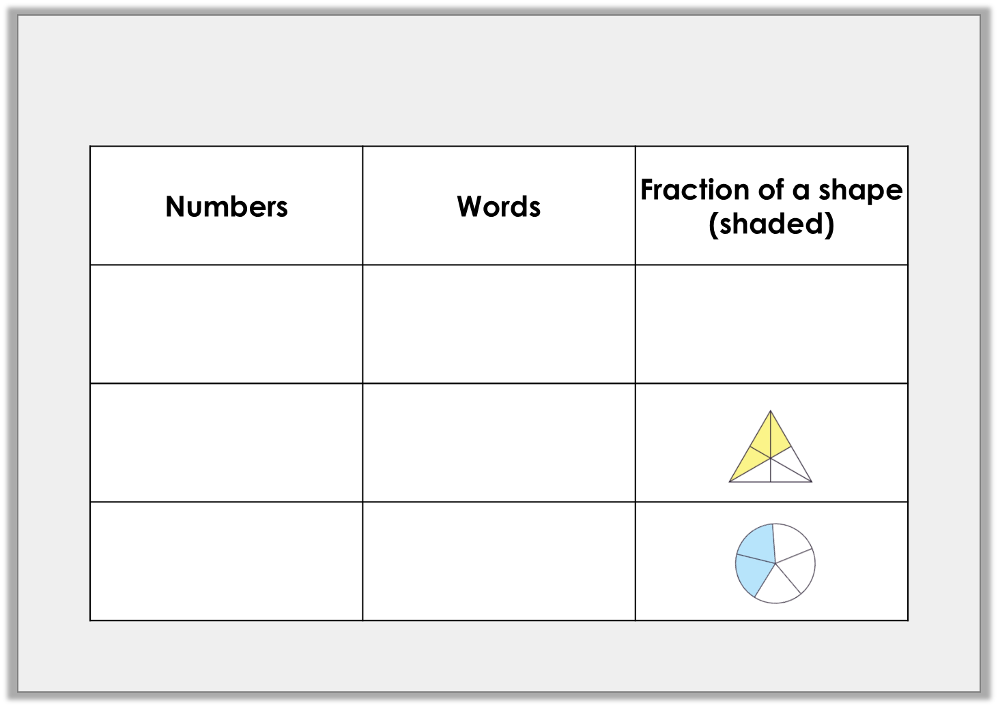
Problem Solving 2
Complete the table.
9
10
Y3
© Classroom Secrets Limited 2019

Slide 6
Problem Solving 2
Complete the table.
9
10
Nine tenths
3
6
Three sixths
2
5
Two fifths
Y3
© Classroom Secrets Limited 2019

Slide 7

Reasoning 1
Sally has picked some flowers.
She says,
Do you agree? Explain your reasoning.
I can use a unit fraction to represent the proportion of sunflowers.
Y3
© Classroom Secrets Limited 2019

Slide 8
Reasoning 1
Sally has picked some flowers.
She says,
Do you agree? Explain your reasoning.
No because…
I can use a unit fraction to represent the proportion of sunflowers.
Y3
© Classroom Secrets Limited 2019

Slide 9
Reasoning 1
Sally has picked some flowers.
She says,
Do you agree? Explain your reasoning.
No because of the flowers are sunflowers which is a non-unit fraction.
I can use a unit fraction to represent the proportion of sunflowers.
3
7
Y3
© Classroom Secrets Limited 2019

Slide 10
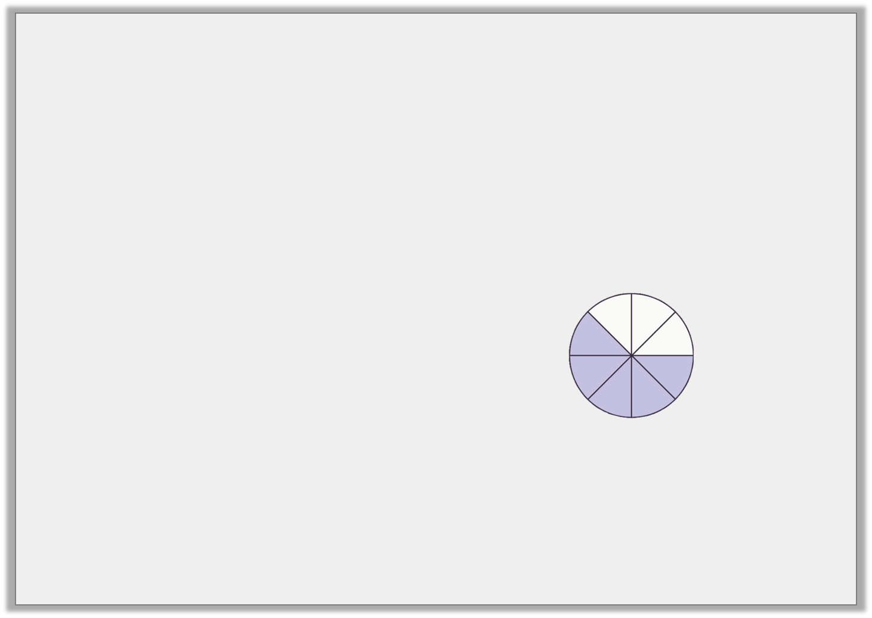
Problem Solving 1
Which image is the odd one out?
Redraw the image to show the correct fraction.
A.
B.
C.
D.
5
8
0 |  |  |  |  |  |  |  | 1
Y4
© Classroom Secrets Limited 2019

Slide 11
Problem Solving 1
Which image is the odd one out?
Redraw the image to show the correct fraction.
Various possible images, for example:
A.
B.
C.
D.
5
8
0 |  |  |  |  |  |  |  | 1
Y4
© Classroom Secrets Limited 2019

Slide 12
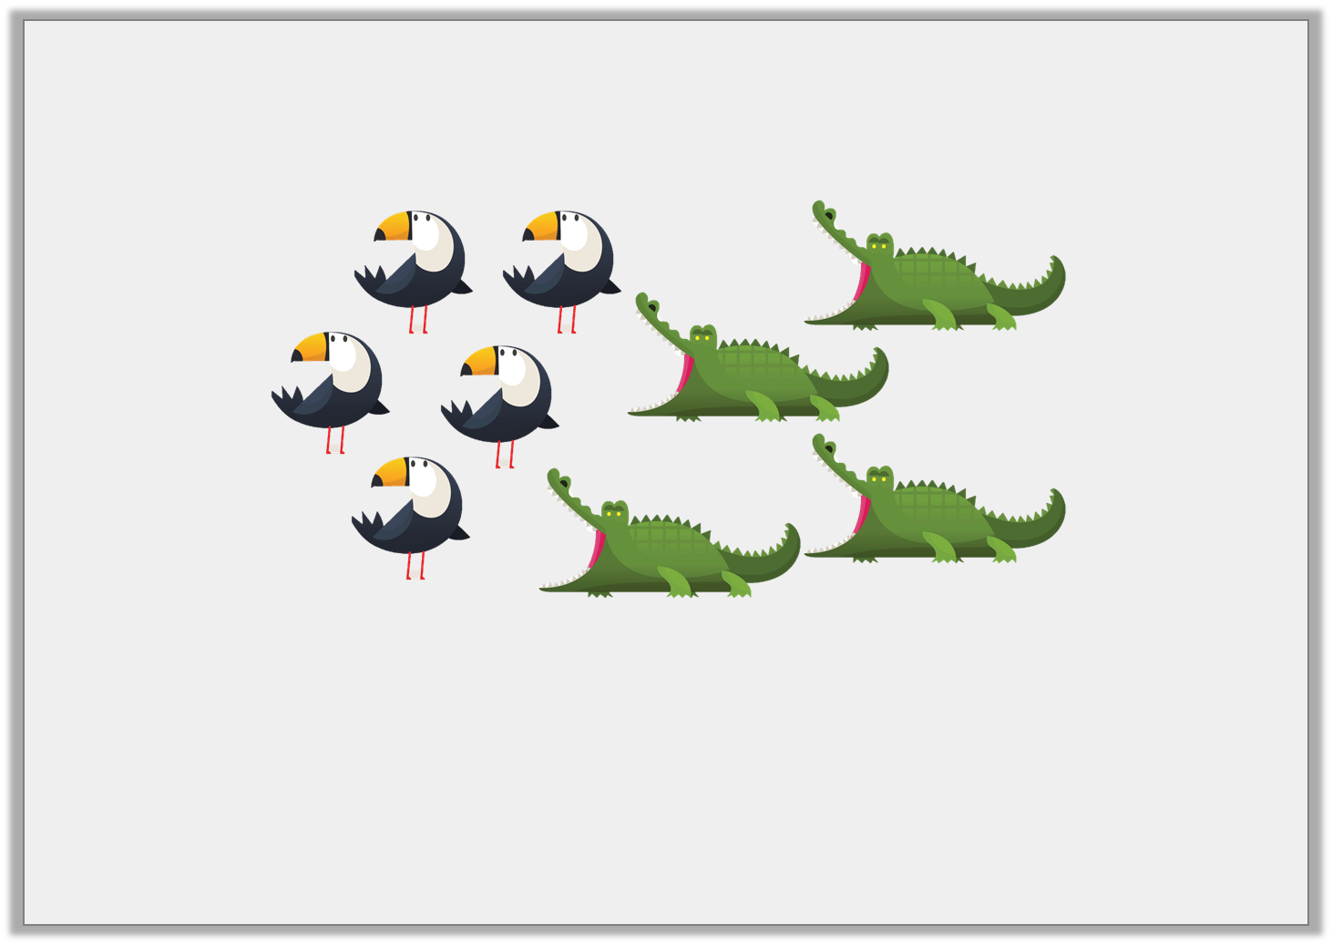
Reasoning 1
Josh thinks one of the fractions being represented below is .
Is he correct? Prove it.
4
5
Y4
© Classroom Secrets Limited 2019

Slide 13
Reasoning 1
Josh thinks one of the fractions being represented below is .
Is he correct? Prove it.
Josh is incorrect because…
4
5
Y4
© Classroom Secrets Limited 2019

Slide 14
Reasoning 1
Josh thinks one of the fractions being represented below is .
Is he correct? Prove it.
Josh is incorrect because the whole is 9.
The fraction should be or .
4
5
5
9
4
9
Y4
© Classroom Secrets Limited 2019

Slide 15
Reasoning 2
Tara has placed a fraction on the number line.
Is she correct? Explain how you know.
3
12
0 |  |  |  |  |  |  |  |  |  |  |  | 1
Y4
© Classroom Secrets Limited 2019

Slide 16
Reasoning 2
Tara has placed a fraction on the number line.
Is she correct? Explain how you know.
Tara is incorrect because...
3
12
0 |  |  |  |  |  |  |  |  |  |  |  | 1
Y4
© Classroom Secrets Limited 2019

Slide 17
Reasoning 2
Tara has placed a fraction on the number line.
Is she correct? Explain how you know.
Tara is incorrect because she has placed the fraction in the middle of the number line which would be .
3
12
0 |  |  |  |  |  |  |  |  |  |  |  | 1
6
12
Y4
© Classroom Secrets Limited 2019

Slide 18
Plenary

