Slide 1
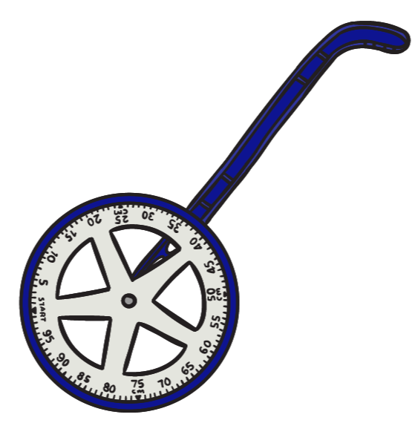
Length and Perimeter
Maths Mastery - Year 3
I can measure, compare, add and subtract:
Lengths (m/cm/mm)
I can measure the perimeter of simple 2D shapes
Small Steps:
Measure length
Equivalent lengths – m & cm
Equivalent lengths – mm & cm
Compare lengths
Add lengths
Subtract lengths
Measure perimeter
Calculate perimeter

Slide 2
Information
Small Step: Measure Length
Children will be introduced to millimetres for the first time and build on their understanding of centimetres and metres.
Children can use different measuring equipment including rulers, tape measures, metre sticks and trundle wheels. They discuss which equipment is the most appropriate depending on the object they are measuring.
Mathematical Talk
What would be the best equipment to measure ____ with? (e.g. tape measure, ruler, metre stick)
What do we have to remember when using a ruler to measure?
Which unit of measurement are we going to use to measure? Centimetres or millimetres?
What unit of measure would be best to measure ____ ?

Slide 3
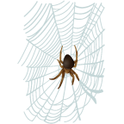
Lesson 1 - Rapid Recall
A spider has 8 legs. How many legs do 2 spiders have in total?
What about 3 spiders?...
What about 4 spiders?

Slide 4
Lesson 1 - Rapid Recall
Answers
A spider has 8 legs. How many legs do 2 spiders have in total? 16
What about 3 spiders? 24
What about 4 spiders? 32

Slide 5
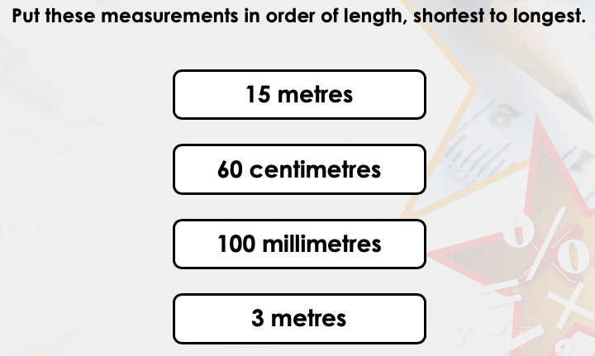
Lesson 1
Small Step: Measure Length
Can you remember the units we use when measuring length?
Which is the longest and which is the shortest unit of length – metre/centimetre?
What do you think about millimetres? Do you think they are longer or shorter than a centimetre?
Can you order the measurements from shortest to longest?

Slide 6
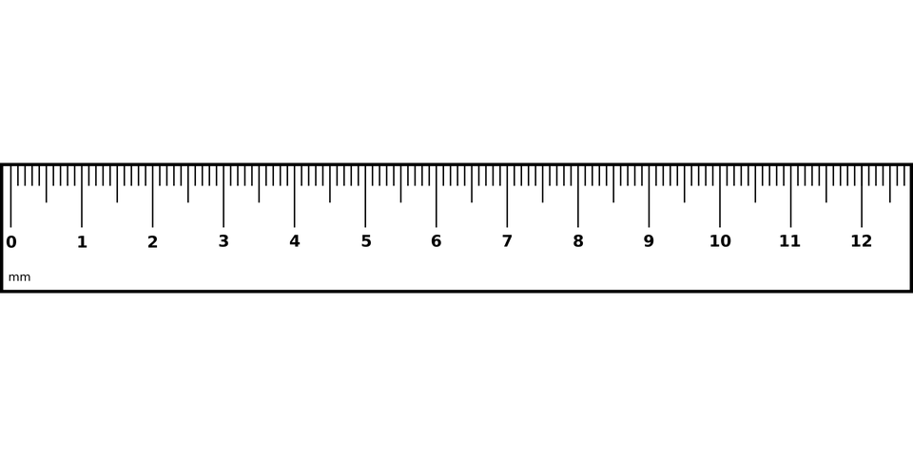
There are 10 millimetres (mm) in every 1 centimetre (cm)
Lesson 1
Small Step: Measure Length
The tiny lines in between the whole centimetres (cm) are called millimetres (mm)
This arrow is pointing to 9.1cm or 9cm and 1mm
This arrow is pointing to 11.7cm or 11cm and 7mm
This longer line is half way between each centimetre so it equals = 0.5cm or 5mm
These are whole centimetres (cm)
So this arrow is half way between 5cm and 6cm so it equals = 5.5cm or 5cm and 5mm

Slide 7
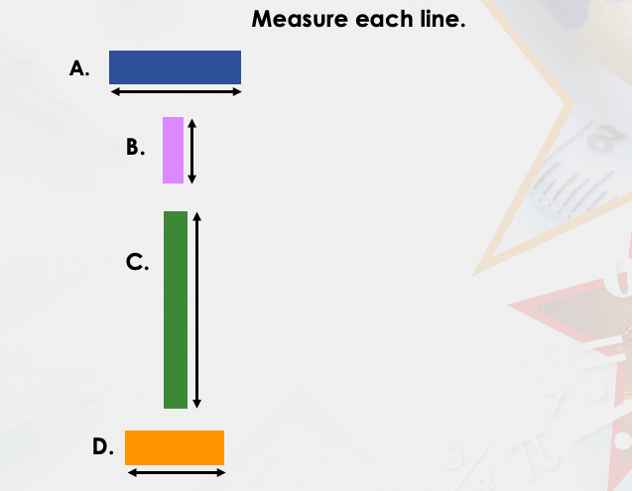
Lesson 1
Small Step: Measure Length (VF)
This week we are going to start looking at measuring length.
Can you measure each line with a ruler?

Slide 8
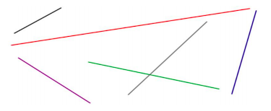
Lesson 1
Small Step: Measure Length (VF)
What about these lines? Can you measure these ones?

Slide 9
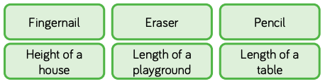
Lesson 1
Small Step: Measure Length (VF)
What unit of measurement would you use to measure these real life objects?
millimetres
centimetres
metres

Slide 10
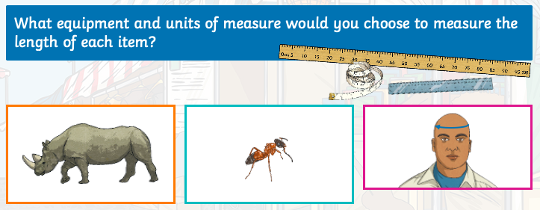
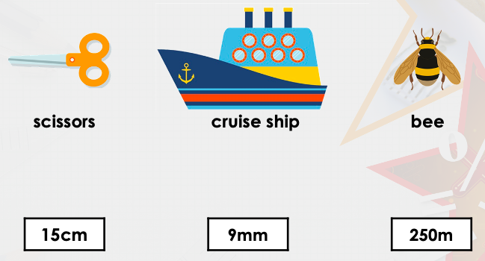
Lesson 1
Small Step: Measure Length (VF)
Metre stick, tape measure or ruler? Which one would you use and why?
Match each object to their correct measurement

Slide 11
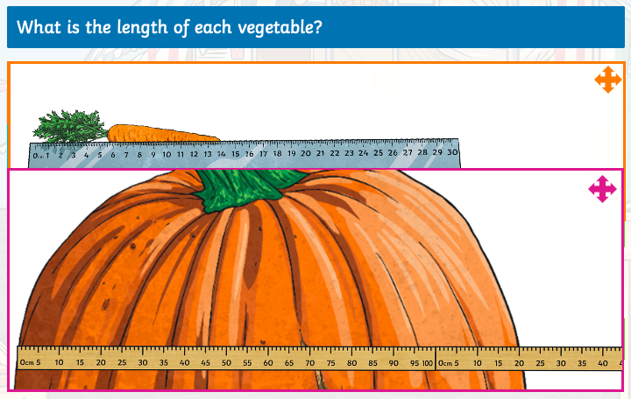
Lesson 1
Small Step: Measure Length (VF)

Slide 12
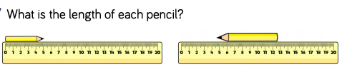
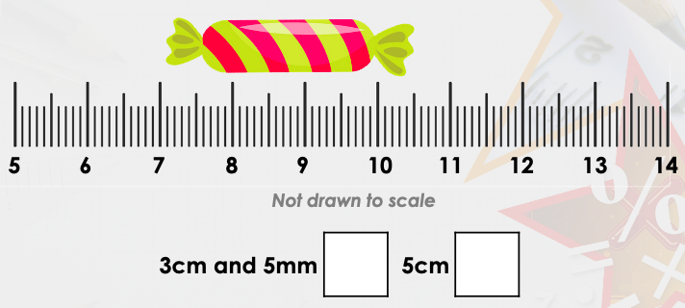
Lesson 1
Small Step: Measure Length (VF)
Take care with this one, look at where they have placed the pencil on the ruler…why is this one trickier to work out?
Which length is correct for the sweet? How did you work it out?

Slide 13
Lesson 1 – Slide Answers
Small Step: Measure Length (VF)
SLIDE 1 – 100 millimetres, 60 centimetres, 3 metres, 15 metres
SLIDE 2 (varied fluency) – A. 2.5cm/2cm and 5mm B. 1.2cm/1cm and 2mm
C. 3.7cm/3cm and 7mm D. 1.8cm/1cm and 8mm (answers may vary slightly depending on the ruler)
SLIDE 3 (varied fluency) – Black – 3.3cm Red – 15cm Green – 8.3cm Purple – 5.3cm Grey - 6.6cm Blue – 5.4cm (answers may vary slightly depending on the ruler)
SLIDE 4 (varied fluency) – millimetres (fingernail/eraser) centimetres (pencil) metres (height of a house/length of a playground/length of a table)
SLIDE 5 (varied fluency) – rhino = metre stick ant = ruler head = tape measure
Scissors = 15cm cruise ship = 250m bee = 9mm
SLIDE 6 (varied fluency) – carrot = 14cm pumpkin = 120cm or 1m 20cm
SLIDE 7 (varied fluency) – pencil 1 = 5cm pencil 2 = 7.5cm sweet = 3cm and 5mm

Slide 14
Lesson 1
Small Step: Measure Length (VF)
Now see if you can have a go at the Activities for Lesson 1.
THEN
If you are finding it a little tricky you can try – Amber Activities
If you are ready for more of a challenge you can try – Purple Activities

Slide 15
Lesson 2 – Rapid Recall
A robot needs 4 batteries. How many batteries do 3 robots need?
How many batteries do 4 robots need?...
What about 5 robots?

Slide 16
Lesson 2 – Rapid Recall
Answers
A robot needs 4 batteries. How many batteries do 3 robots need?
12
How many batteries do 4 robots need?...
16
What about 5 robots?
20

Slide 17
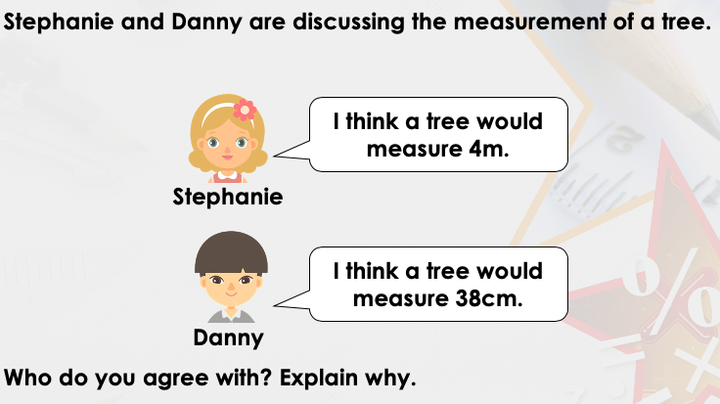
Lesson 2
Small Step: Measure Length (R)
Today we are going to look at some ‘reasoning’ questions.
Remember these are the ones that require you to explain or prove your answers to me.

Slide 18
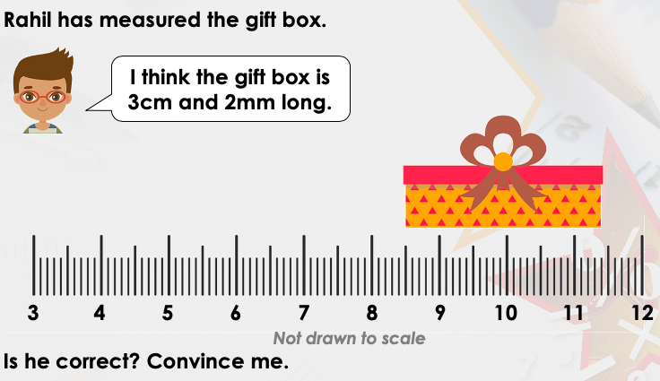
Lesson 2
Small Step: Measure Length (R)

Slide 19
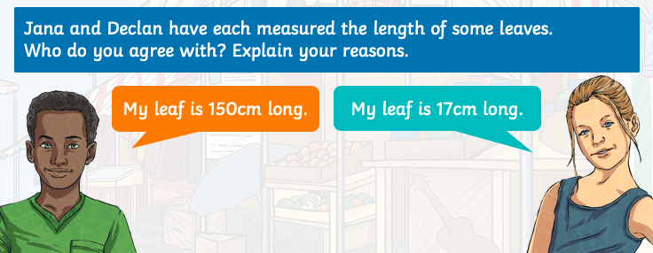
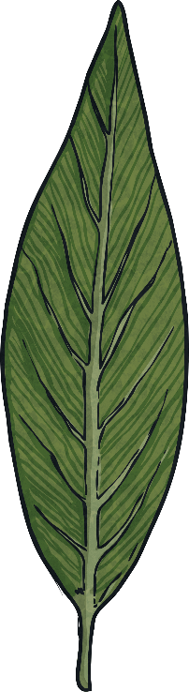
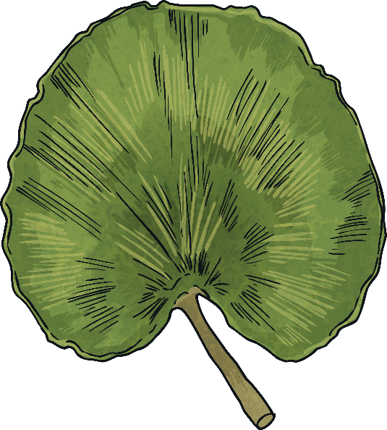
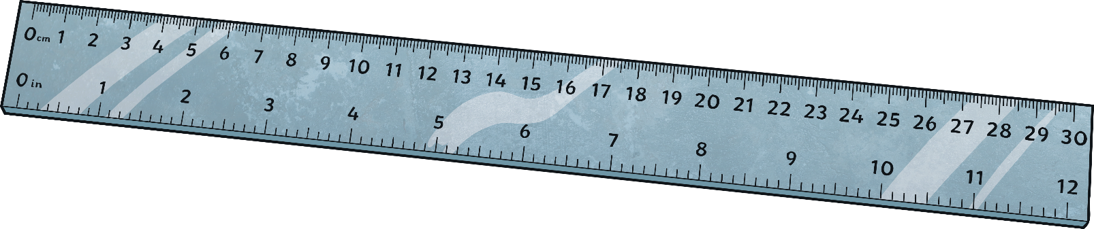

Lesson 2
Small Step: Measure Length (R)
Explain your reasoning and answer carefully.
How can you show your working out?

Slide 20
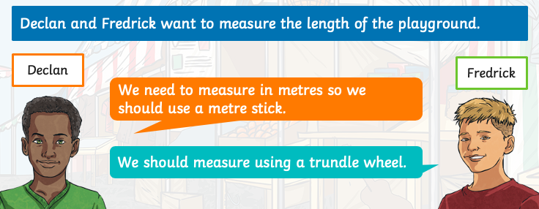
Lesson 2
Small Step: Measure Length (R)
Who do you agree with? Explain your reasons.
What is a trundle wheel?
How is it different from a metre stick?

Slide 21
Lesson 2 – Slide Answers
Small Step: Measure Length (R)
SLIDE 1 (reasoning) - I would agree with Stephanie because a tree would most likely measure 4m not 38cm.
SLIDE 2 (reasoning) – No, Rahil is incorrect because the gift box measures approximately 2cm and 9mm or 29mm.
SLIDE 3 (reasoning) - Declan is not correct – he has measured his leaf in millimetres but used the wrong unit of measurement. His leaf is 150mm long. Jana is not correct – she has lined her leaf up with the wrong end of the ruler. Her leaf is 13cm long.
SLIDE 4 (reasoning) – Fredrick's method is more appropriate. A trundle wheel will be easier to use to measure a long distance in metres. Using a metre stick would be tricky.

Slide 22
Lesson 2
Small Step: Measure Length (R)
Now see if you can have a go at the Activities for Lesson 2.
THEN
If you are finding it a little tricky you can try – Amber Activities
If you are ready for more of a challenge you can try – Purple Activities

Slide 23
Lesson 3 – Rapid Recall
If it’s 5 o’ clock now, what time was it 3 hours ago?
What time will it be in 4 hours?...
How about in 7 hours?

Slide 24
Lesson 3 – Rapid Recall
Answers
If it’s 5 o’ clock now, what time was it 3 hours ago? 2 o’clock
What time will it be in 4 hours 9 o’clock .
How about in 7 hours? 12 o’clock

Slide 25
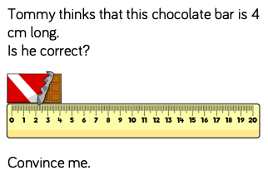
Lesson 2
Small Step: Measure Length (PS)
RECAP
Let’s see what you can remember from the previous lesson.

Slide 26
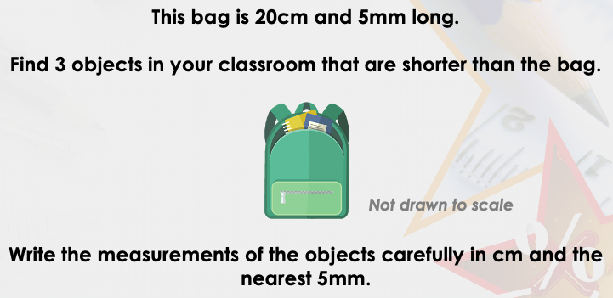
Lesson 3
Small Step: Measure Length (PS)
Today we are going to look at some ‘problem solving’ questions.
Remember these are the ones that require you to think a little bit deeper and use lots of your mastery skills.
This bag is 20cm and 5mm long.
Find 3 objects in your house that are shorter than the bag.
REMEMBER – the more detail you can give in an answer the greater your depth of understanding is!

Slide 27
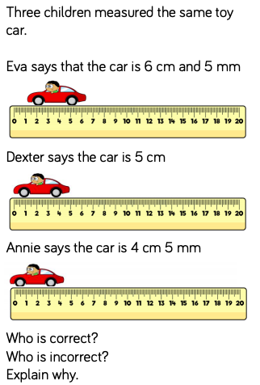
Lesson 3
Small Step: Measure Length (PS)
Have a go at this question…
Remember to use your deeper thinking skills to help you problem solve.

Slide 28
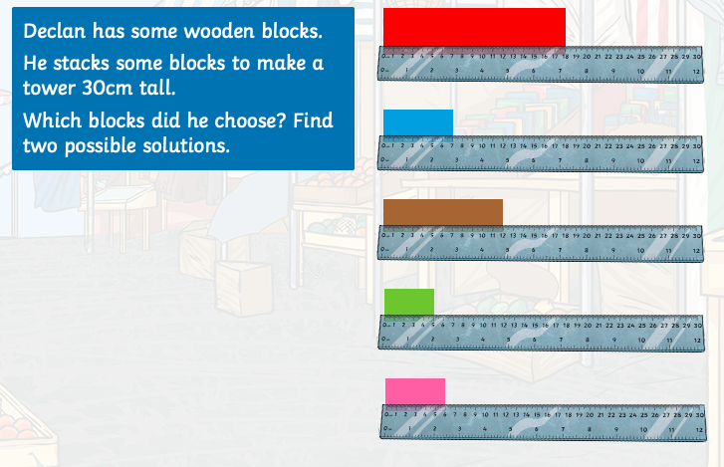
Lesson 3
Small Step: Measure Length (PS)
REMEMBER – the more solutions you can give in an answer the greater your depth of your understanding is!
Remember to show your working out too!

Slide 29
Lesson 3 – Slide Answers
Small Step: Measure Length (PS)
SLIDE 1 – He is incorrect because he has not placed the chocolate bar at 0, he has put it at the end of the ruler.
SLIDE 2 (problem solving) – Various answers, for example: Pen; pencil; scissors. Ensure measurements are recorded accurately.
SLIDE 3 (problem solving) - Dexter is correct. The other two children have not lined up the ruler correctly: Eva has started at 1 cm and 5 mm instead of 0 and Annie has started at the end of the ruler.
SLIDE 4 (problem solving) – There are multiple, possible answers.
Declan could have used the red, blue and green blocks.
He could have used the brown and red blocks.
He could have used the blue, brown, pink and green blocks.

Slide 30
Lesson 3
Small Step: Measure Length (PS)
Now see if you can have a go at the Activities for Lesson 3.
THEN
If you are finding it a little tricky you can try – Amber Activities
If you are ready for more of a challenge you can try – Purple Activities

Slide 31
Lesson 4
Weekly Mental Maths
1. 13 + 6 =

Slide 32
Lesson 4
Weekly Mental Maths
2. 17-9 =

Slide 33
Lesson 4
Weekly Mental Maths
3. 14 + 6 +12 = 32

Slide 34
Lesson 4
Weekly Mental Maths
4. What is 650 add three hundreds?

Slide 35
Lesson 4
Weekly Mental Maths
5. What is 674 + 8 =

Slide 36
Lesson 4
Weekly Mental Maths
6. 785 - ___ =755

Slide 37
Lesson 4
Weekly Mental Maths
7. 4 x 9 =

Slide 38
Lesson 4
Weekly Mental Maths
8. Make the biggest number out of 5,3,7?

Slide 39
Lesson 4
Weekly Mental Maths
9. 24 donuts are shared between 3 people, how many do each people get?

Slide 40
Lesson 4
Weekly Mental Maths
10. 250 + ______ = 600

Slide 41
Lesson 4
Weekly Mental Maths
11. 167 + 421 =

Slide 42
Lesson 4
Weekly Mental Maths
12. 566 – 269 =

Slide 43
Lesson 4
Weekly Mental Maths
Answers
Answer
1. 19 | 7. 36
2. 8 | 753
3. 32 | 8
4. 950 | 10. 350
5. 682 | 11. 588
6. 30 | 12. 297

