Slide 1
Jigsaw: Dreams and Goals
Outcome:
To identify a dream/ambition that is important to me
To imagine how I will feel when I achieve my dream/ambition

Slide 2
Warm Up Activity
Talk with another family member about 10 things you are grateful for in your life today.
E.g having a cup of tea, having a computer to do school work on, speaking to our class on teams.

Slide 3
Calm me
Take some deep breaths
Look out of the window and watch the clouds for a few minutes. What different shapes of clouds can you see?
Does your mind feel calm and ready to learn?

Slide 4
Open my mind
This is Jane Goodall. What do you think she dreamed of as a little girl?

Slide 5
PSHE KS2:
Storytime with Dr. Jane: Reading of Me ... Jane by Patrick McDonnell
Please watch this video:
https://www.youtube.com/watch?v=RFBlNbkAbmQ

Slide 6
Tell me
What were Jane’s dreams and goals?
How did she achieve these?
What are your dreams and goals?
Is it good to have dreams and goals?
How will you achieve your dreams and goals?

Slide 7
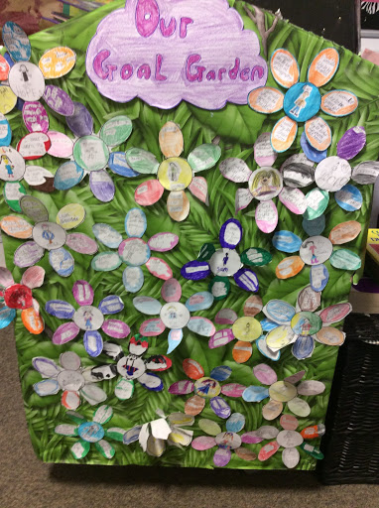

Slide 8
Year 3 Garden of Dreams
On your flower template
1. First I would like you to stick or draw a picture of yourself in the middle of the attached flower template/ your own flower shape
2. Then draw or write your goals for the future on the petals of the flowers. Remember they can be very big goals like Jane!
3.Then stick the flower to a stick/pencil/straw adding leaves if you wish. Please keep hold of it as you will be sharing it with the class soon.
4. If you would like, please place your goal or goals on the ITS learning discussion board.

Slide 9
Help Me Reflect
How do you feel about writing your goals on the flower?
The most interesting thing I found out was …..
Something I didn’t know before this lesson was …….

